Slide 1
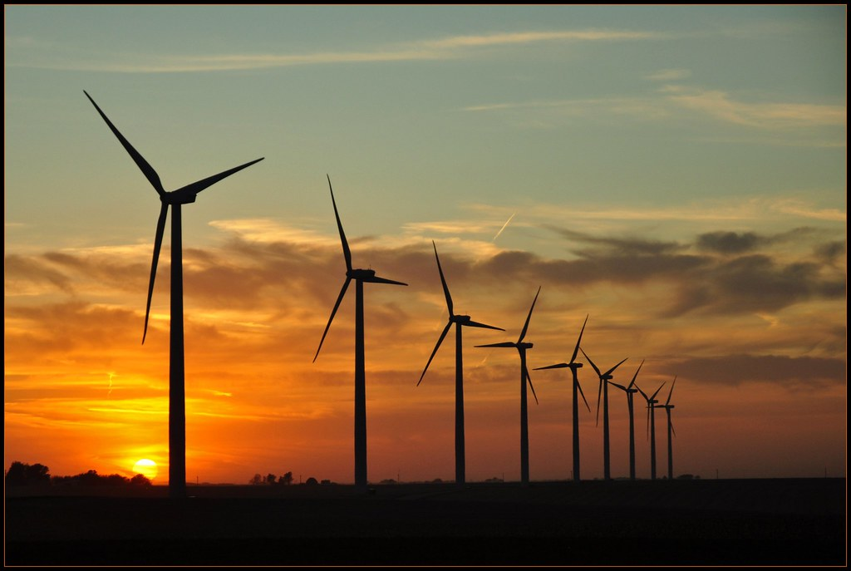
Wind Turbines and the innovation of renewable energy
One Power Company
Team 7
Komal Patel, Sean Patterson, Sakari Prescott, Andrew Rehbein, Teela Papp, and Deshaun Riddick
MIS540: Innovation Through Technology
Dr. James Karagiannes
June 22, 2025

Slide 2
TABLE OF CONTENTS
Executive Summary
Introduction
Project Plan
Organization Background
Business Problem & Opportunity Overview
Overview of the Technology Solution
Alternative Solutions and Recommendations
Performance Measurement Plan
Organizational Impact
Summary – Conclusion
Bibliography

Slide 3

Executive Summary
Overview:
One Power Company (OPC) delivers site-based wind energy and Managed High Voltage (Manage dHV®) solutions to industrial facilities across the U.S.
Core Offerings:
Wind for Industry®: On-site utility-scale wind turbines
Manage dHV® Systems: Customized high-voltage systems combining grid + wind
Customer Focus:
Heavy industries: food production, chemical, packaging
Goals: Lower long-term costs, increase energy reliability, reduce carbon footprint
Market Position:
Competes with large-scale providers (GE, Vestas, Siemens Gamesa)
Differentiated by decentralized, customer-centric energy systems
Aligned with government priorities (DOE Distributed Wind Market Report, 2023)

Slide 4
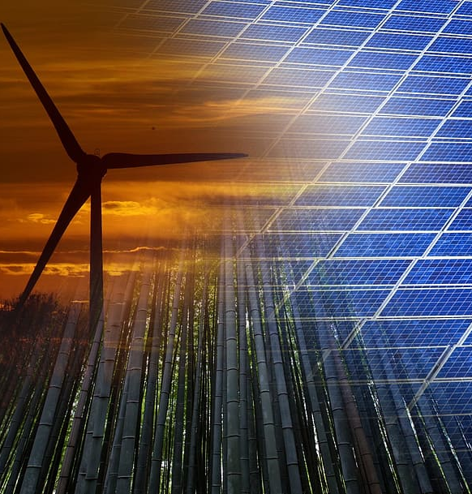
Introduction
The presentation explores One Power Company’s initiative in developing renewable energy with a state-of-the-art high-voltage distribution system. As the demand for alternative energy sources increases, the need for innovative energy solutions becomes more critical in an industrial and large manufacturing industry. All while looking for new innovative concepts to access other markets
This Presentation is structured into five key sections
The Company Background
The Business Problem and Opportunity
The Technology Solution
Organizational Impact
The Conclusion

Slide 5
Project plan 6 stages of wind development
Step One: Screening
Completed by an analytics team
Five Steps:
Airport Proximity
Wind Source
Land Availability
Energy Consumption
Power Pricing
Step Two: Feasibility
Completed by Project Manager (PM)
PM creates a preliminary report to determine project size, siting, energy production, economics, and viability. Report is completed with 95% confidence rate.
Step Three: Development
Completed by Engineering
Confirmation of finding from step one and two, a detailed evaluation is performed. Engineering reviews and goes to “shovel ready.”
Step Four: Contract Execution
Completed by C-Suite Executives, Accountants, and Auditors
An approval for the turbine purchase is made, it’s a 20-year agreement.
Step Five: Project Delivery
Completed by Public Relations
Made of four concurrent activities
Permitting
Public-Roll Out
Procurement
Construction
Step Six: Project Delivery
Completed by Service Team
Once the project is up and running, the service team continues to monitor the systems. Ensuring the system is to par.

Slide 6
Organization Background
Founded in 2009 by Jereme Kent in Marshall MN
Missions: to reduce carbon emissions and fossil fuel dependency
Operating as a parent company for multiple subsidiaries
Deployed over 541 wind turbines in the US and Latin America
Pioneered the first digital transmission voltage substation in 2023
Continues to innovate and renewable infrastructure
Poised to become a global leader in sustainable energy

Slide 7

Business Problem and Opportunity Overview
Paradigm shift in wind energy leaving behind the traditional 3 blade to oscillating systems
Grave ecological threats to avian and bat population
Bladeless turbine technology
Public demand and regulatory scrutiny

Slide 8
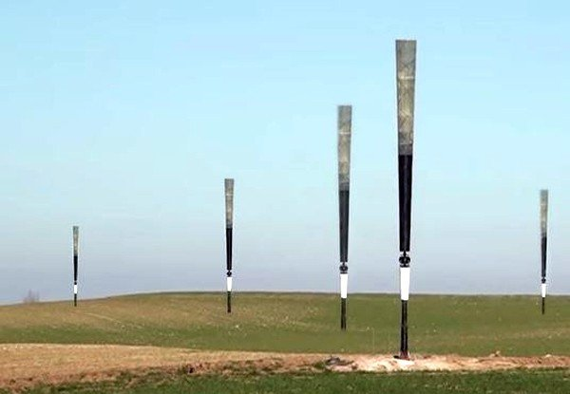
Overview of the Technology solution
Advanced Materials Science and AI-driven design and simulation
Leveraging cutting edge materials to enhance the energy capture and durability, bladeless designs.
Expanding the ability to provide the power of wind into previously inaccessible markets.

Slide 9
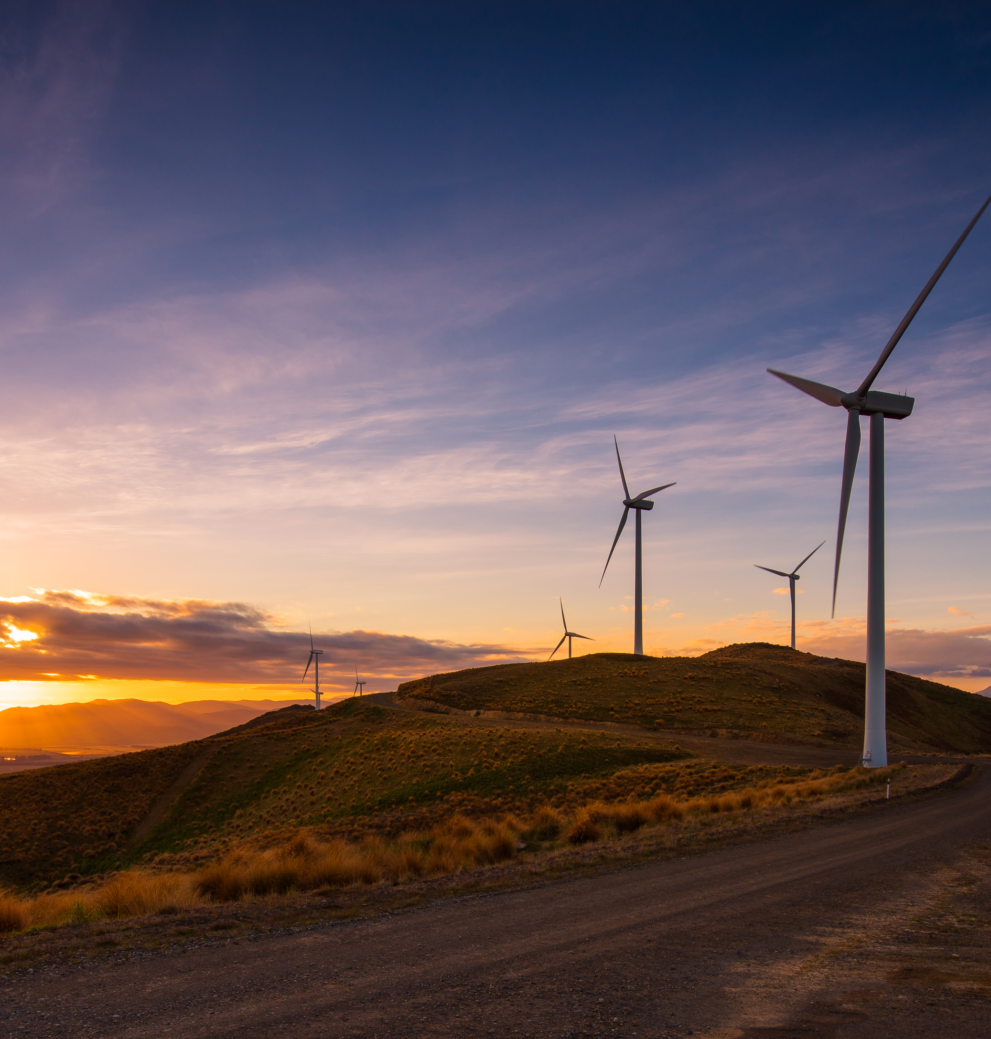
Alternative Solutions and Recommendations
One power is exploring bladeless wind turbine technology to impact the environment less negatively
Vortex Bladeless (Spain) Oscillating Mast to generate up to 100W with no blades, risk to environment and 50% less cost reduction manufacturing
Aeromine Technologies (USA) produces 5kW on rooftops
Recommendation is Aeromine Technologies for high output

Slide 10

Performance Measurement Plan
One Power delivers high-efficiency, wind-integrated energy solutions for industrial facilities.
Real-time monitoring and smart analytics ensure system reliability and performance.
Structured KPIs track technical success, user satisfaction, and investor interest.
Monthly and quarterly reviews drive continuous improvement and scalability.
The plan supports One Power’s strategic growth and leadership in sustainable energy.

Slide 11
Organizational impact
Expanded Market Reach
Stronger Competitive Edge
Higher Profits
Enhances Trust with Brands
Improved Safety Operations
Data-Driven innovation

Slide 12

CONCLUSION
Strategic Growth Trajectory
Unlocking New Markets
Operational Excellence
Transformative Impact
Enhanced Profitability & Reputation
Empowering Customers

Slide 13
Thank you for your time
Q & a

Slide 14
bibliography
American Clean Power. (2020). Wind power 101. ACP; American Clean Power. https://cleanpower.org/facts/wind-power/
Business Wire. (2025, May 21). One Power Company secures strategic private investment to accelerate industrial power expansion. Business Wire. https://www.businesswire.com/news/home/20250521629018/en/One-Power-Company-Secures-Strategic-Private-Investment-to-Accelerate-Industrial-Power-Expansion
Clemens, K. C. (2022, November 3). Aeromine: An Elegantly Simple Rooftop Wind Energy Solution. eepower.com. Retrieved June 15, 2025, from https://eepower.com/tech-insights/aeromine-an-elegantly-simple-rooftop-wind-energy-solution/#
Electric Power Monthly - U.S. Energy Information Administration (EIA). (n.d.). Www.eia.gov. https://www.eia.gov/electricity/monthly/epm_table_grapher.php?t=epmt_5_3
Electricity for Manufacturing. (n.d.). ElectricityPlans. https://electricityplans.com/landing/electricity-for-manufacturing/
Envision Energy. (2024). Our mission. https://www.envision-group.com/
GE Renewable Energy. (2024). Wind energy. https://www.ge.com/renewableenergy/wind-energy
Han, S. (2019, August 29). 10 Amazing Advantages of Wind Energy - Everglades University [Updated]. Everglades University. https://www.evergladesuniversity.edu/blog/10-advantages-wind-energy/
Horner, H. (2024, December 18). Bladeless-wind-turbines-engineering-the-future. Retrieved June 15, 2025, from https://www.eit.edu.au/bladeless-wind-turbines-engineering-the-future/
Kitepower. (2024). Airborne wind energy systems. https://kitepower.nl/
Layton, J., & Gleim, S. (2019, April 4). Do Wind Turbines Cause Health Problems? HowStuffWorks. https://science.howstuffworks.com/environmental/green-science/wind-turbines-health.htm
One Power Company. (2025). Wind for Industry: On-site wind energy solutions for industrial facilities. Retrieved May 12, 2025, from https://onepower.com/future-customers/introducing-wind-for-industry/
One Power Company. (n.d.). Introducing: Wind for Industry. One Power Company. Retrieved May 25, 2025, from https://onepower.com/future-customers/introducing-wind-for-industry/
One Power Company. (n.d.). A wind project: Step by step. Retrieved May 28, 2025, from https://onepower.com/future-customers/a-wind-project-step-by-step/
One Power Company. (n.d.). Market studies. Retrieved May 28, 2025, from https://onepower.com/op-labs/market-studies/
One Power Company. (n.d.). Vision and thesis. Retrieved May 28, 2025, from https://onepower.com/about-one-power/vision-and-thesis/
One Power Company. (n.d.). Introducing: ManagedHV services provided by One Power. Retrieved May 28, 2025, from https://onepower.com/future-customers/introducing-managedhv-services-provided-by-one-power/
One Power Company. (n.d.). The Continuum Project. Retrieved May 28, 2025, from https://onepower.com/op-labs/the-continuum-project/
Orrell, A., Sheridan, L., Kazimierczuk, K., Fensch, A., & Pacific Northwest National Laboratory. (2023). Distributed Wind Market Report: 2023 Edition. U.S. Department of Energy. https://www.energy.gov/sites/default/files/2023-08/distributed-wind-market-report-2023-edition_0.pdf
Repsol. (2024). Bladeless wind turbines: The future of wind power. https://www.repsol.com/en/energy-and-the-future/future-of-the-world/bladeless-wind-turbines/index.cshtml
Shibboleth Authentication Request. (n.d.-b). https://www.proquest.com/docview/2314599582?parentSessionId=ww8Wk0cGF9KZzupZpiIpqhIQTWMXGuywlBFYt2lAC0g%3D&pq-origsite=summon&accountid=44759&sourcetype=Scholarly%20Journals
Siemens Gamesa. (2024). Renewable energy solutions. https://www.siemensgamesa.com/en-int
Super User. (2016). Re-inventing the Windmill by The Archimedes. Thearchimedes.com. https://thearchimedes.com/
Vestas. (2024). Global leader in wind energy. https://www.vestas.com/
Vortex Bladeless. (2024). A new paradigm in wind energy. https://vortexbladeless.com/

